Slide 1

Bone fracture Detection Model
https://github.com/Harshvardhansanguri/Bonefracturedetectionmodel/tree/main
PRANAV GUPTA
E23CSEU0301

Slide 2
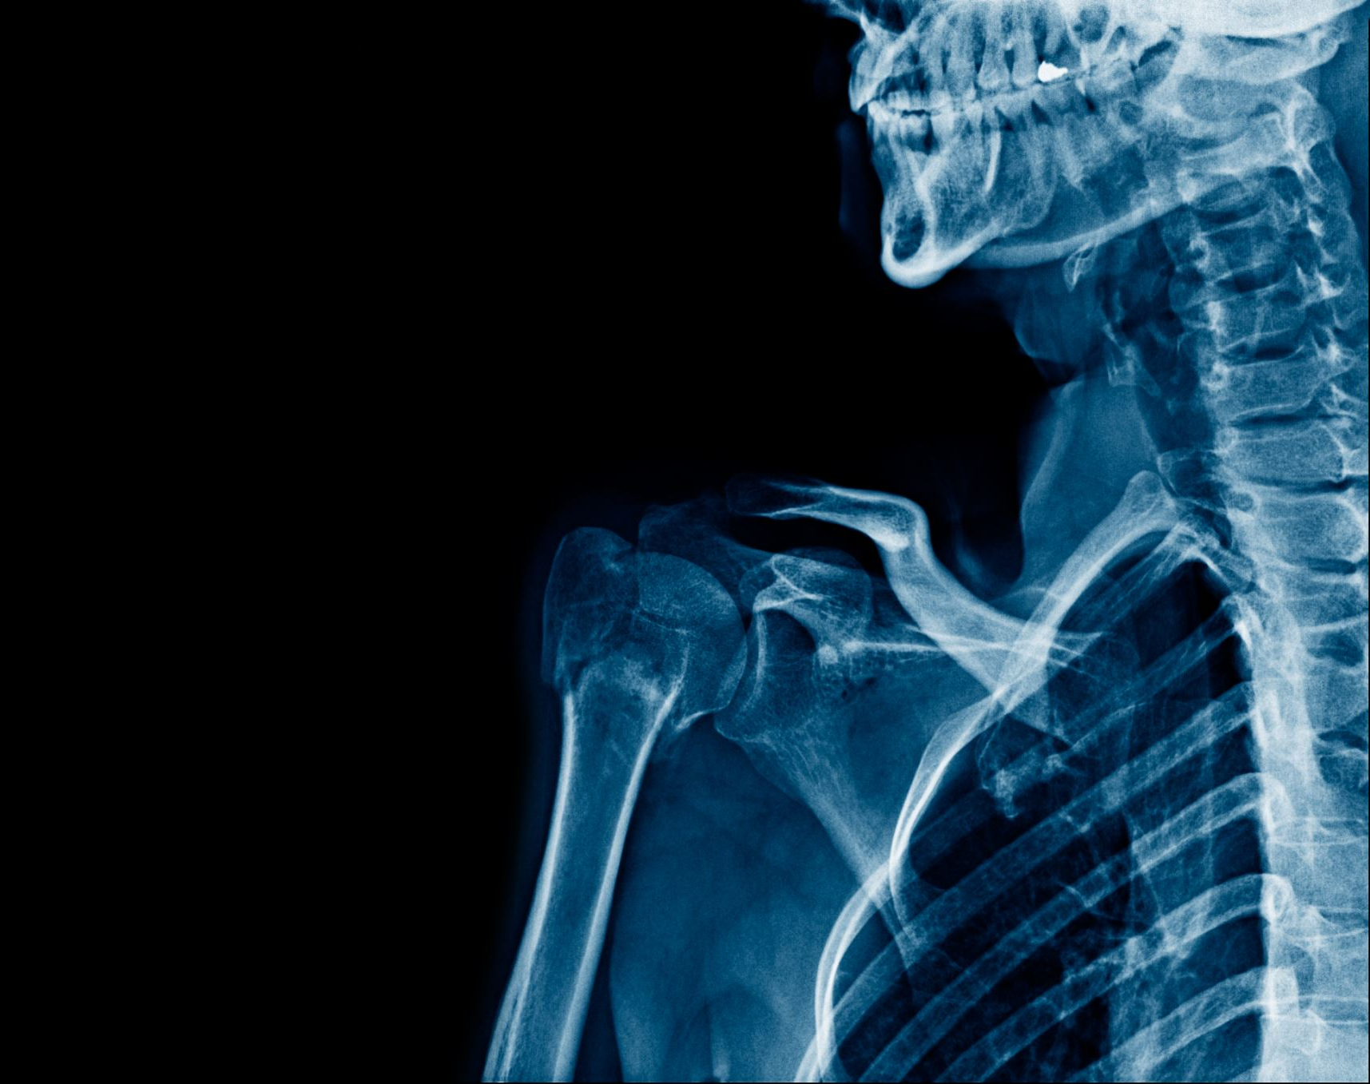
INTRODUCTION
Bone fractures are a common medical issue requiring accurate and timely diagnosis.
Traditional methods rely heavily on radiologists' expertise, which can be time-consuming and prone to human error.
This project leverages AI and computer vision to automate the detection of bone fractures in X-ray images, aiming to enhance diagnostic accuracy and efficiency.

Slide 3

Objective
Develop an AI model capable of detecting and classifying various types of bone fractures from X-ray images.
Improve diagnostic accuracy and reduce the time required for fracture detection.
Provide a comprehensive dataset to support further research and development in medical imaging.

Slide 4

Dataset Description
The dataset includes X-ray images categorized into classes such as Elbow Positive, Fingers Positive, Forearm Fracture, Humerus Fracture, Shoulder Fracture, and Wrist Positive.
Each image is annotated with bounding boxes or pixel-level segmentation masks to indicate the location and extent of fractures.
The dataset is designed to facilitate the training and evaluation of bone fracture detection algorithms, offering a diverse range of fracture types for robust model development.

Slide 5
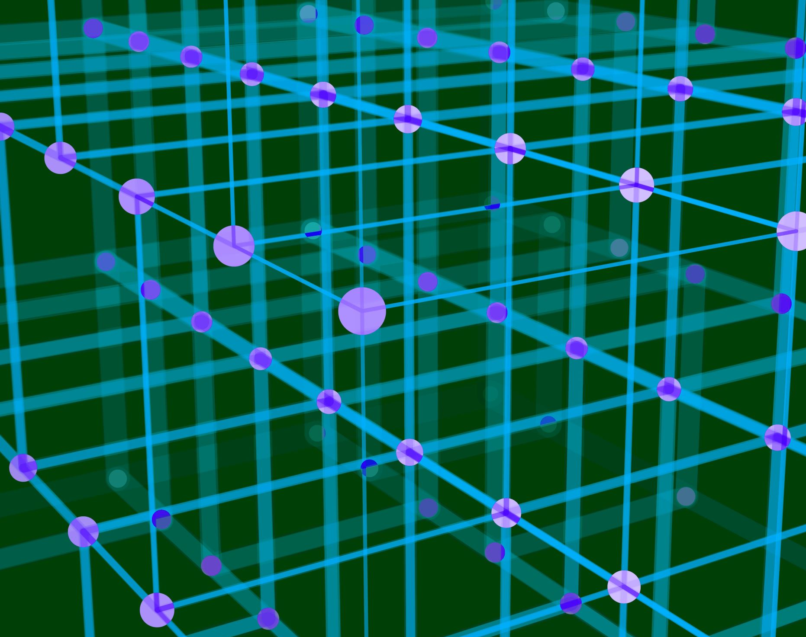
Methodology
Utilized convolutional neural networks (CNNs) for image analysis due to their effectiveness in visual pattern recognition.
Applied transfer learning to leverage pre-trained models, enhancing performance with limited data.
Employed data augmentation techniques to increase the diversity of training samples and improve model robustness.
The model was trained to detect and classify fractures based on annotated X-ray images.

Slide 6

Implementation
Data preprocessing involved normalization and augmentation to prepare the images for training.
The model architecture was selected based on performance benchmarks in medical imaging.
Training involved optimizing hyperparameters and using techniques like cross-validation to ensure generalizability.
The model was evaluated using metrics such as accuracy, precision, recall, and F1-score to assess its performance.

Slide 7
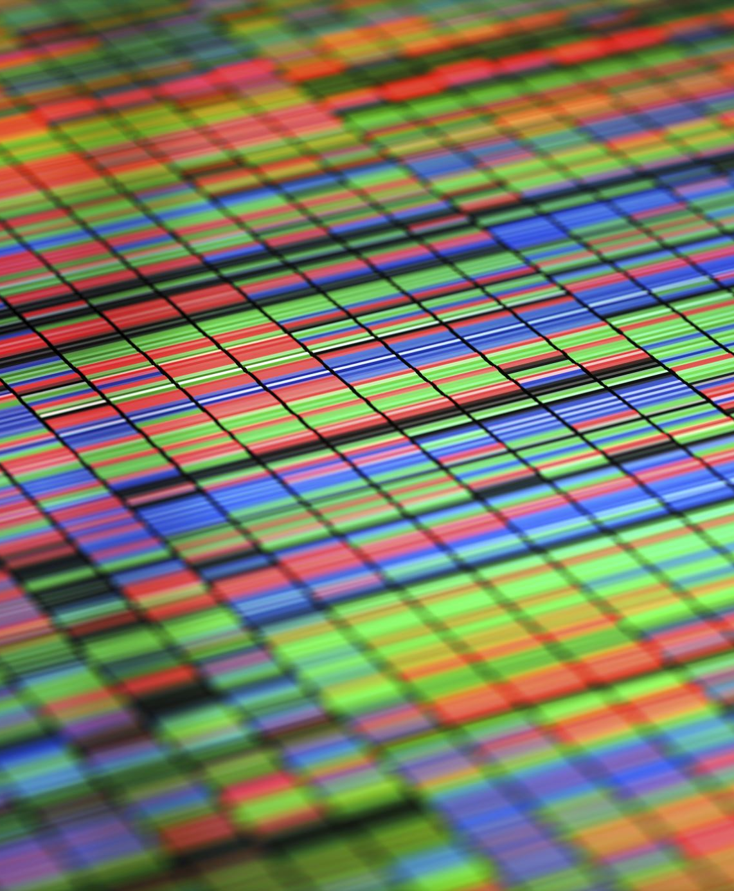
Applications
The AI model can assist radiologists in hospitals and clinics by providing a second opinion on X-ray images.
It can be integrated into medical imaging software to automate the detection process, reducing the workload on healthcare professionals.
The model can also be used in telemedicine, enabling remote diagnosis and consultation, especially in areas with limited access to radiologists.

Slide 8
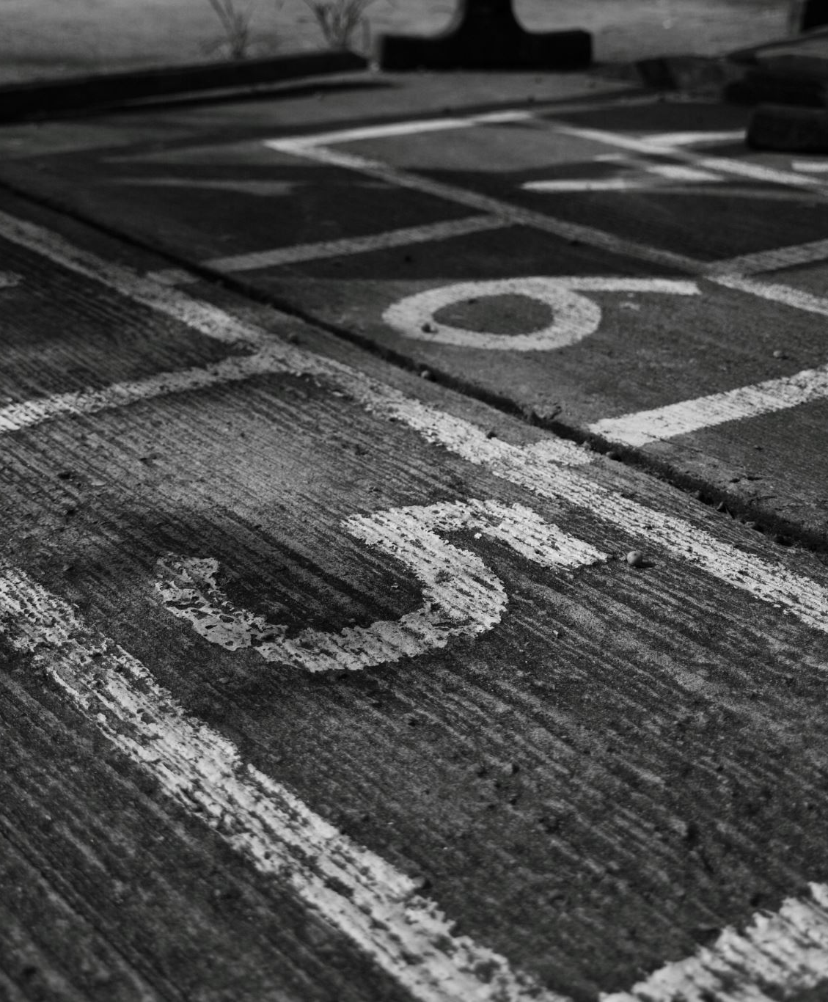
Advantages
Enhanced diagnostic accuracy reduces the likelihood of missed fractures and misdiagnoses.
Faster diagnosis allows for timely treatment, improving patient outcomes.
Reduces the workload on radiologists, allowing them to focus on more complex cases.
Provides a valuable tool for training and research in medical imaging and AI.

Slide 9

Challenges
Data quality issues, such as noise and variability in X-ray images, can affect model performance.
Class imbalance, with some fracture types being less represented, poses a challenge for training.
High computational requirements for training deep learning models necessitate significant resources.
The need for extensive labeled data for effective training can be a limiting factor.
Addressing these challenges involves using advanced preprocessing techniques, data augmentation, and efficient model architectures.

Slide 10

Future Scope
Expanding the dataset to include more types of fractures and anatomical regions can improve model accuracy.
Enhancing the model with advanced techniques like ensemble learning and attention mechanisms.
Integrating the model into clinical workflows for real-time diagnosis and decision support.
Collaborating with medical institutions for further research, validation, and deployment in real-world settings.
Exploring the use of the model in other imaging modalities, such as CT scans and MRIs.

Slide 11
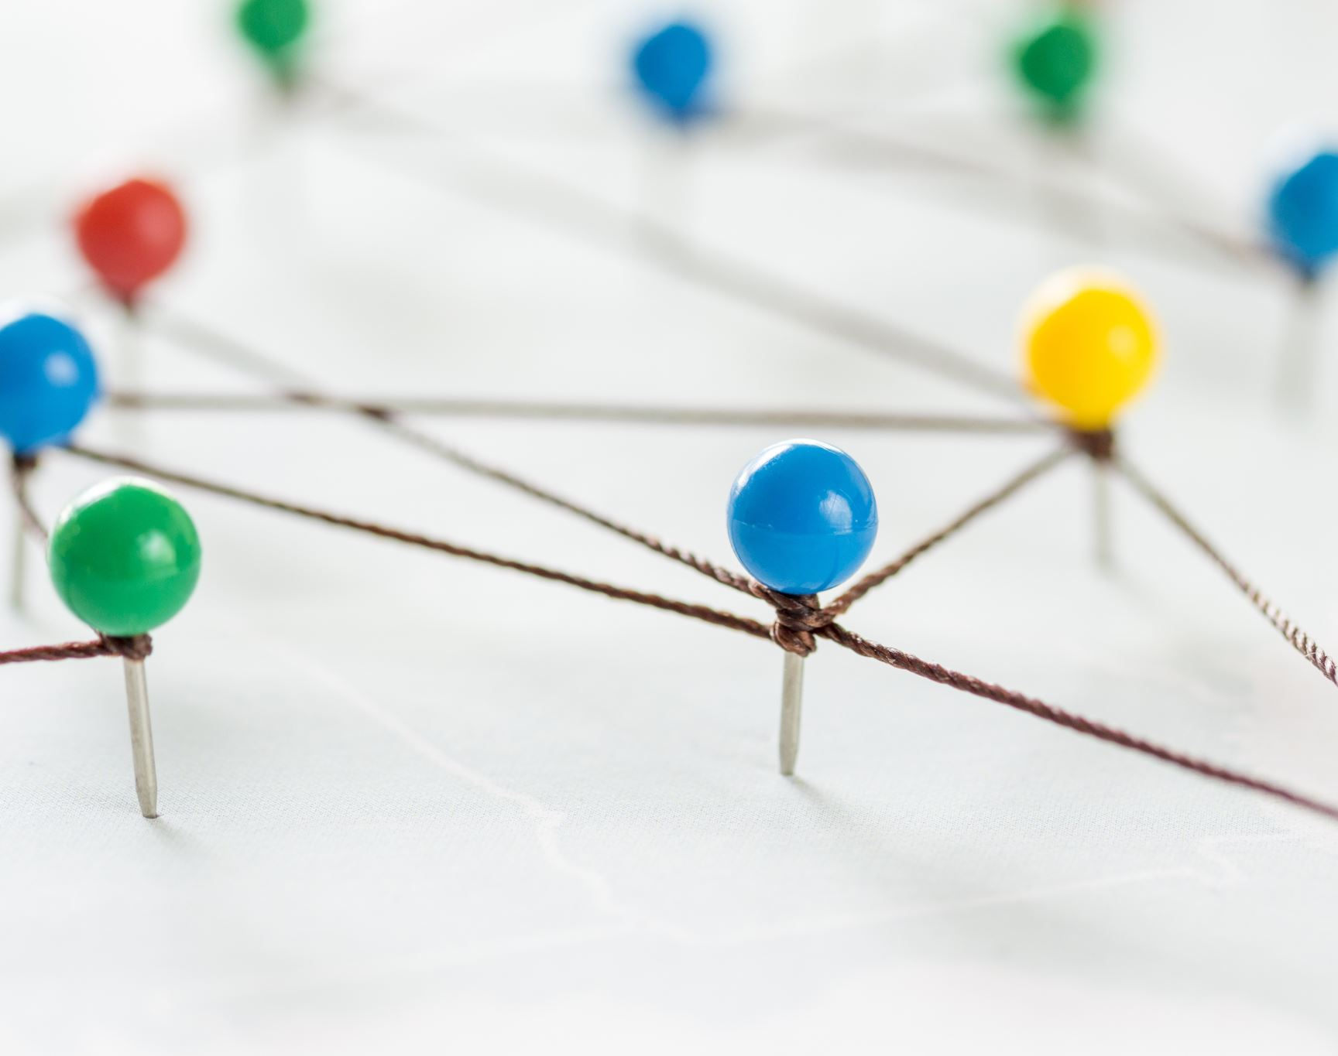
References and GitHub Project Link
https://www.kaggle.com/datasets/pkdarabi/bone-fracture-detection-computer-vision-project/data
https://www.researchgate.net/publication/382268240_Bone_Fracture_Detection_Computer_Vision_Project
https://github.com/pranav8316/Bone-Fracture-Detection-System1

